Slide 1


MALL DATABASE MANAGEMENT SYSTEM
UE20CS301 – Database Management Systems (Minors)
Mini-Project Report

Slide 2
TEAM MEMBERS
Name | SRN
B M MADHUMITHA | PES1UG21EC902
AKSHAY ANGADI | PES1UG21EC030
RAGHAVE S L | PES1UG21EC212

Slide 3
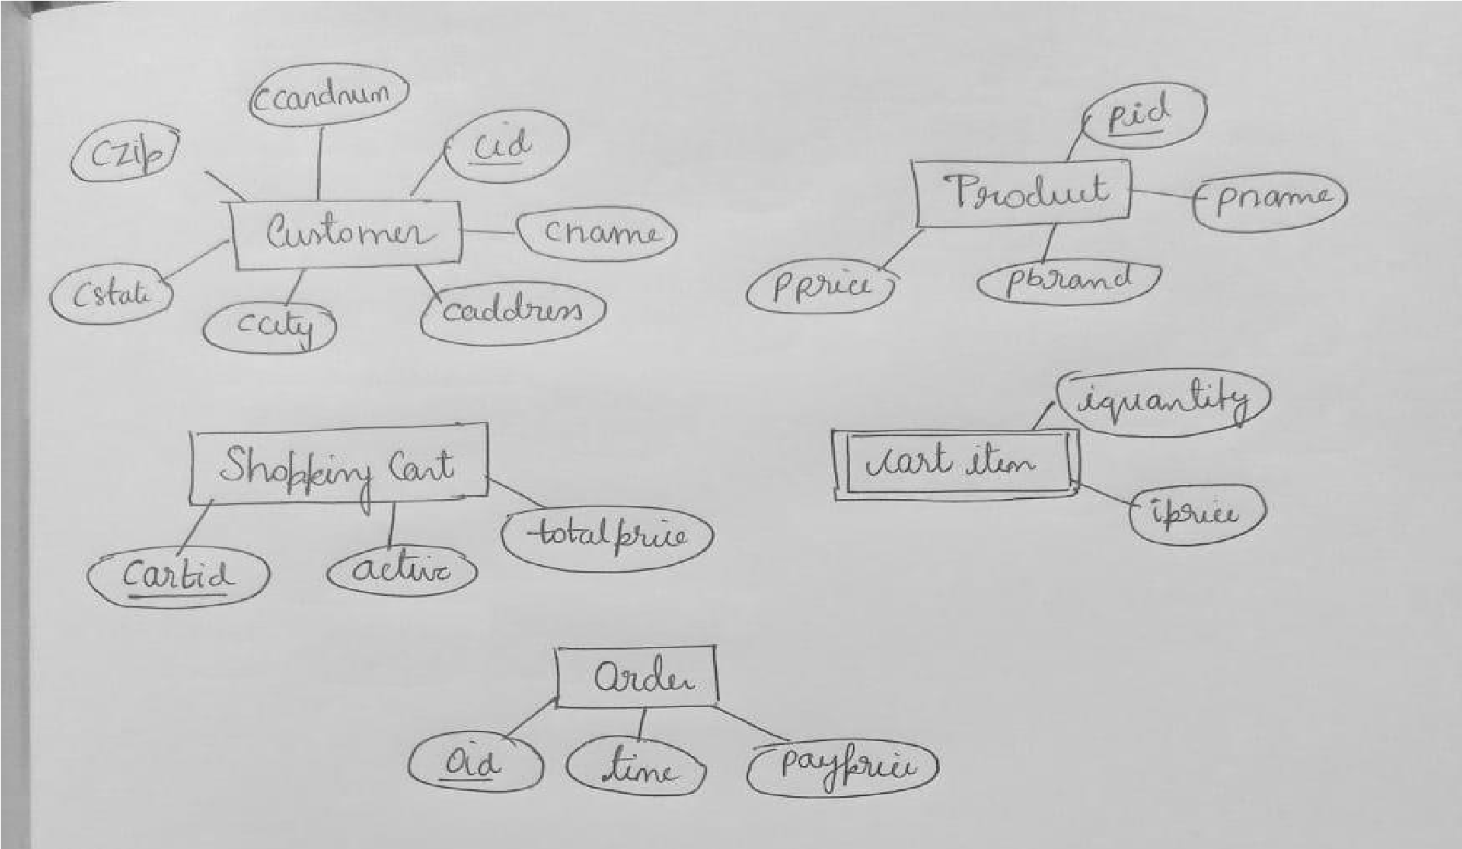
ENTITIES AND ATTRIBUTES

Slide 4
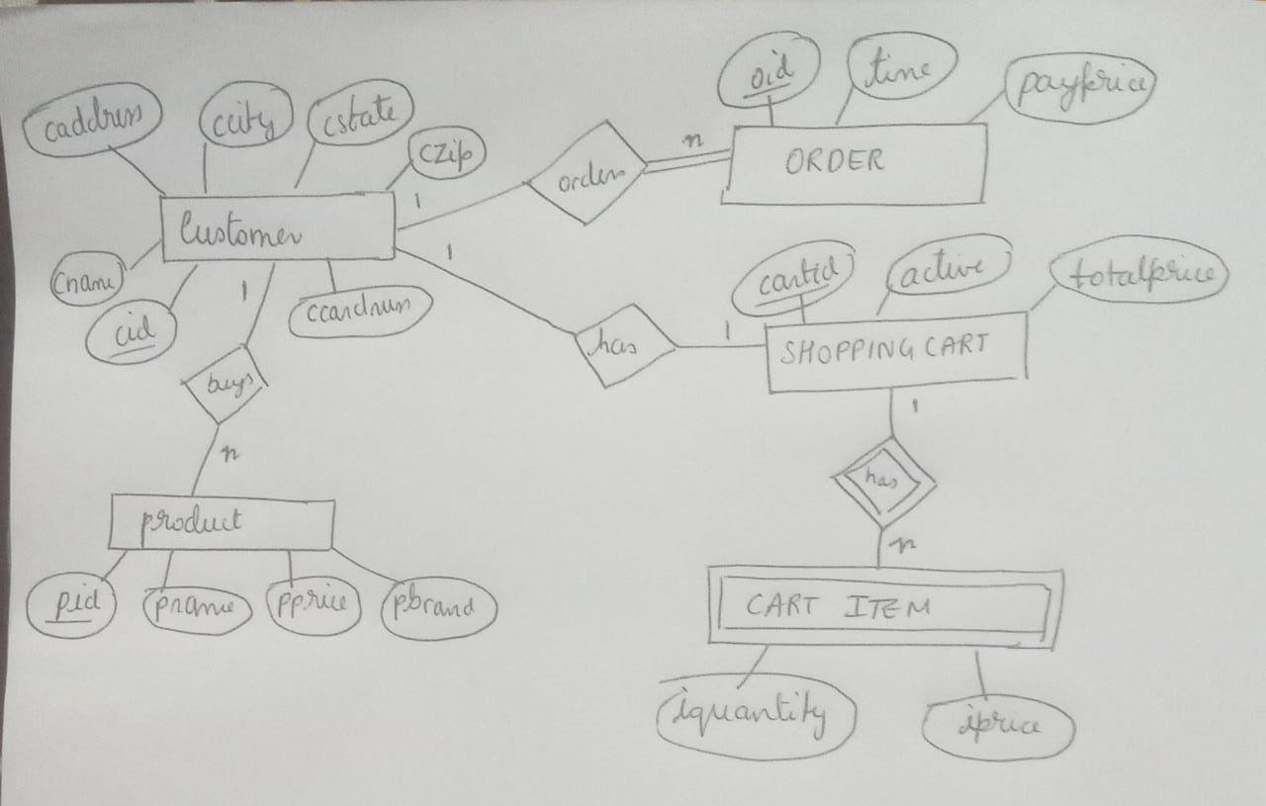
E-R DIAGRAM

Slide 5
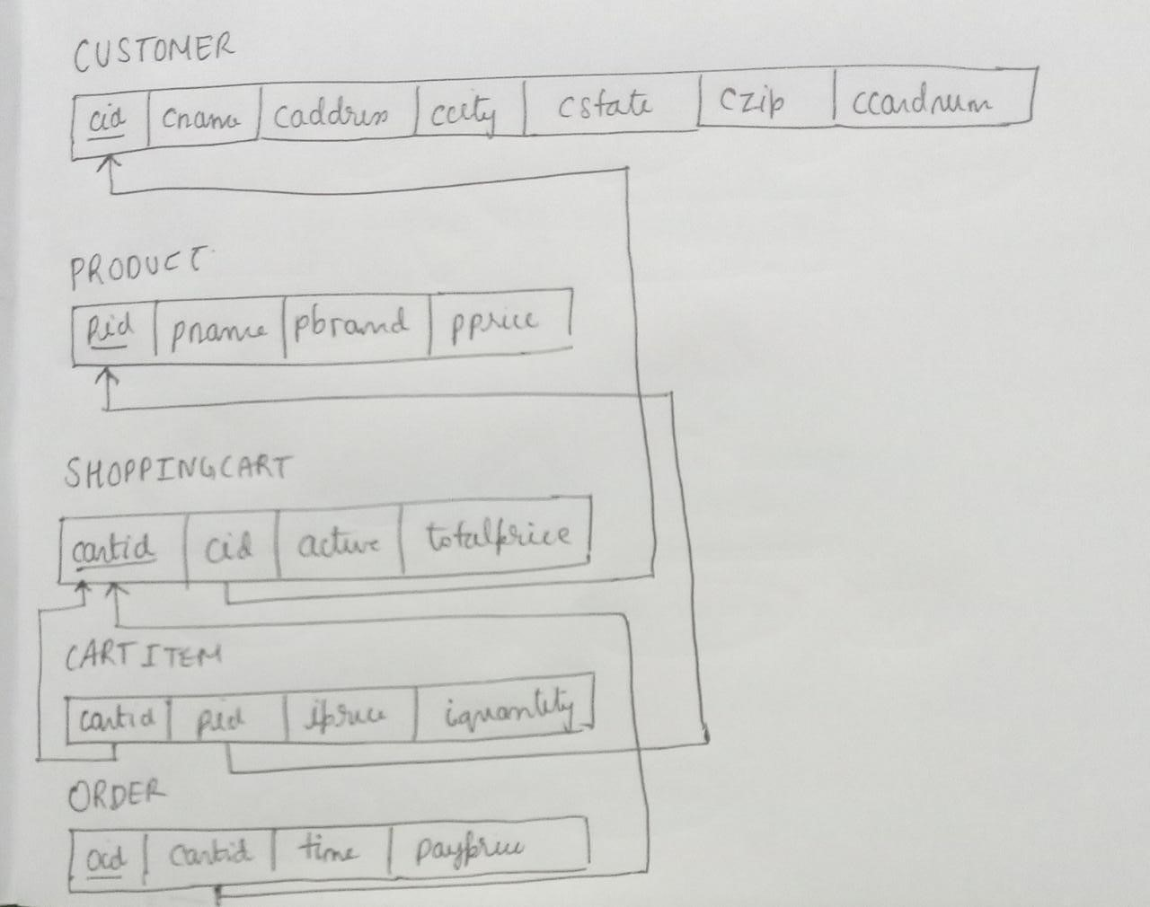
RELATIONAL SCHEMA

Slide 6
QUERIES
create table CUSTOMER(cid int NOT NULL, cname varchar(255),
caddress varchar(255),ccity varchar(25),cstate varchar(25),czip varchar(25),ccardnum varchar(255),PRIMARY KEY(cid));
create table PRODUCT(pid int NOT NULL, pname varchar(255), pbrand
varchar(255), pprice DECIMAL(10,2), PRIMARY KEY(pid));
create table SHOPPING_CART(cartid int NOT NULL, cid int, active
int default 1, totalprice DECIMAL(10,2), PRIMARY
KEY(cartid),FOREIGN KEY (cid) REFERENCES CUSTOMER(cid));
create table CART_ITEM(iprice DECIMAL(10,2), iquantity int,cartid
int, pid int, price int, FOREIGN KEY (cartid)
REFERENCES SHOPPING_CART(cartid),FOREIGN KEY (pid) REFERENCES
PRODUCT(pid));

Slide 7
create table ORDER_t(oid int NOT NULL, cartid int, time TIME , payprice DECIMAL(10,2), PRIMARY KEY(oid), FOREIGN KEY (cartid)REFERENCES SHOPPING_CART(cartid)); For cname in CUSTOMER table add NOT NULL CONSTRAINT: ALTER TABLE CUSTOMER MODIFY cname varchar(255) NOT NULL; CARD NUMBER SHOULD BE UNIQUE: ALTER table CUSTOMER ADD UNIQUE (ccardnum); RENAME TABLE ORDER_t to ORDER_cust Rename table ORDER_t to ORDER_cust; CREATE VIEW for 2nd cart_id order details: Create view 2nd_order_details AS select cartid,pid,iprice,iquantity from CART_ITEM where cartid=2; insert into CUSTOMER (cid,cname,caddress,ccity,cstate,czip,ccardnum) values (1,'aradhya','no.2532, 15th cross, BSK 2nd stage',

Slide 8
'Bangalore','karnataka','560070','984654361762354'); insert into CUSTOMER (cid,cname,caddress,ccity,cstate,czip,ccardnum) values (2,'Maninder','no.7655, 18th cross, Amaravathi 2nd stage', 'Amaravathi','Andhra Pradesh','560034','227138495696302'),(3,'Naya','no.5623, 19th cross, Itanagar 2nd stage', 'Itanagar','Arunachal Pradesh','560054','115886170160191 '),(4,'Ishaan','no.8978, 13th cross, Dispur 2nd stage', 'Dispur','Assam','560023','693317141277093'),(5,'Jai','no.1111, 11th cross,Patna 2nd stage', 'Patna','Bihar','560012','718978106833907'),(6,'Inaya','no.2323, 18th cross, Raipur 2nd stage', 'Raipur','Chhattisgarh','560088','773897952020970'),(7,'Amar','no. 2532, 12th cross, Panaji 2nd stage', 'Panaji','Goa','560071','9942724291700247'),(8,'Navi','no.2542, 29th cross, Gandhi 2nd stage', 'Gandhinagar','Gujarat','560453','134562244867778'),(9,'aadira','n o.1987, 37th cross, Chandigarh 2nd stage',

Slide 9
'Chandigarh','Haryana','560010','959417838538581'),(10,'abhi','no. 2352, 16th cross, Simla 2nd stage', 'Shimla','Himachal Pradesh','560080','380884706153595'),(11,'manu','no.2222, 18th cross, Ranchi 2nd stage', 'Ranchi','Jharkhand','560450','141021046946817'),(12,'vinoth','no. 4343, 45th cross, Trivandrum 2nd stage', 'Trivandrum','Kerala','5600560','070876750973812'),(13,'manjula',' no.1824, 10th cross, Bhopal 2nd stage', 'Bhopal','Madhya Pradesh','560270','190304788460859'),(14,'dhruv','no.135, 9th cross, Mumbai 2nd stage', 'Mumbai','Maharashtra','560370','245400304669155'),(15,'kanan','no .2590, 8th cross, Imphal 2nd stage', 'Imphal','Manipur','562370','105599942367286'); select * from CUSTOMER;

Slide 10
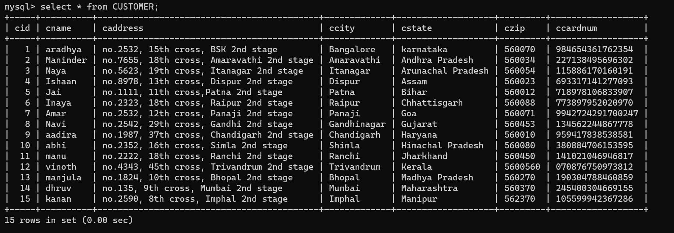
insert into PRODUCT (pid,pname,pbrand,pprice) values (1,'Analog Black dial ','TIMEX ',1851.50),(2,'Dial coloured strap ','TIMEX ',2586.50),(31,'Men’s formal shoes ','CENTRINO ',697),(4,'Men 5951-35 ','CENTRINO ',2299),(5,'Women’s slider ','URJO ',1099.50),(6,'ANGULAR HOLDER KITCHEN KNIVES ','PIGEON ',695.50),(7,'GALAXY M14 5G','SAMSUNG ',14990.50),(8,'NORD CE 2 LITE','ONE PLUS ',18499.50),(9,'ULTRA SHEER DRY TOUCH','neutrogena',1867.50),(10,'NUTRI BLEND MIXER ','WONDERCHEF',2598.50);

Slide 11
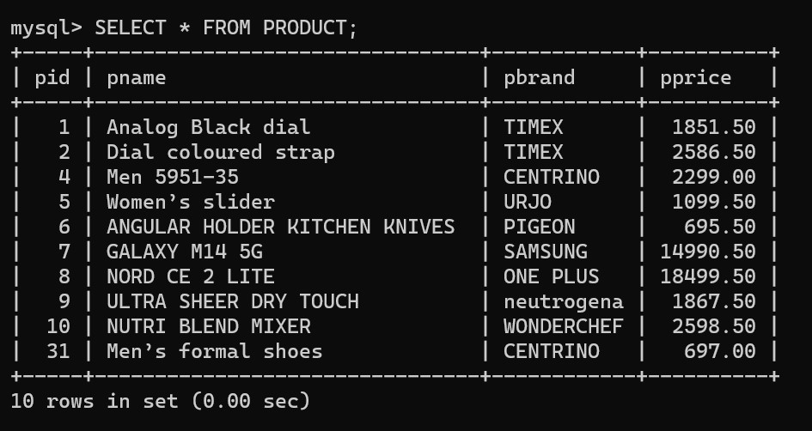
Insert into SHOPPING_CART(cartid,cid,active) values(1,1,1), (2,2,1),(3,3,0),(4,4,1),(5,5,1),(6,6,1),(7,7,1),(8,8,1),(9,9,1),(1 0,10,1),(11,11,1),(12,12,1),(13,13,1),(14,14,1),(15,15,0); DROP COLUMN TOTAL_PRICE:

Slide 12
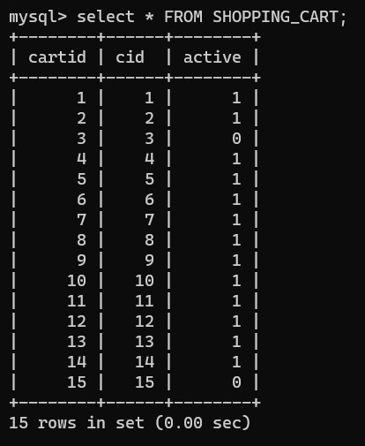
ALTER TABLE SHOPPING_CART DROP COLUMN totalprice;

Slide 13
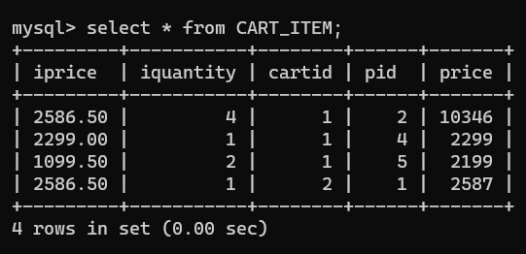
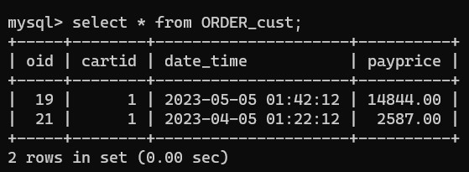

Slide 14
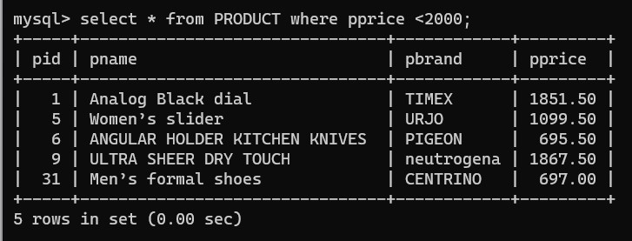
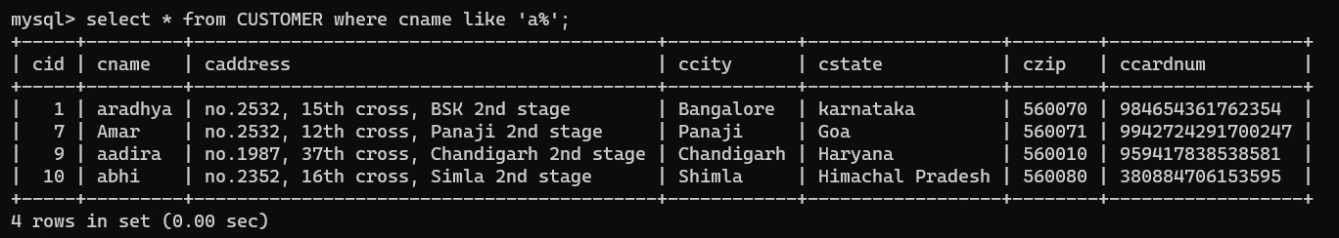
Display all products whose price is within 2000:
Display the customer whose name starts with the letter ‘a’

Slide 15
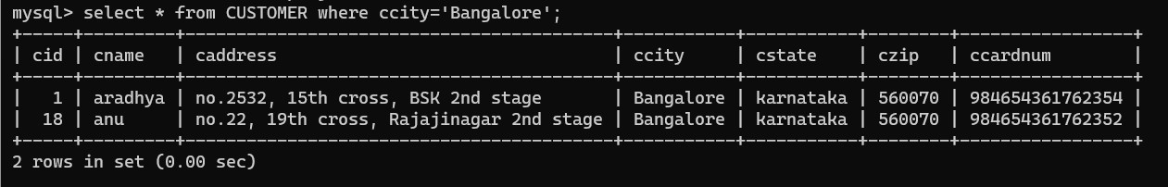
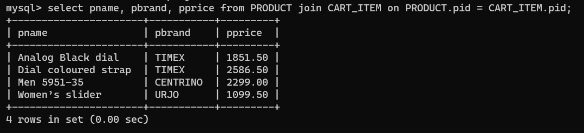
Find the customer details who are from Bangalore:
Select the information of products which were ordered:

Slide 16
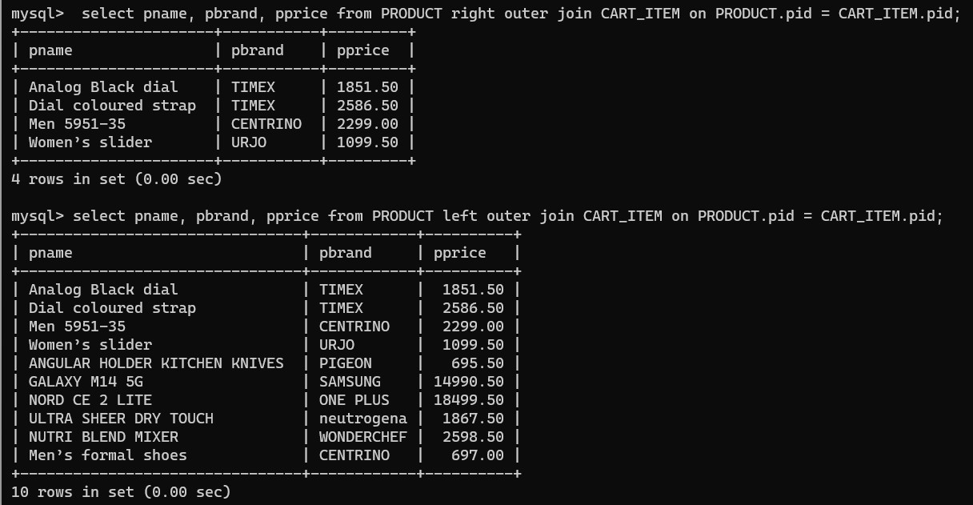
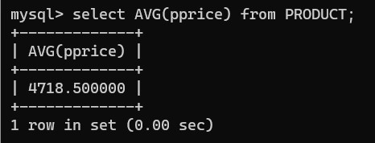
Average price of products:

Slide 17
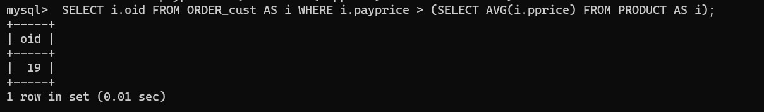
Determine the OID who has amount greater than the average amount:
Determine the OID who has amount greater than the average amount:

Slide 18
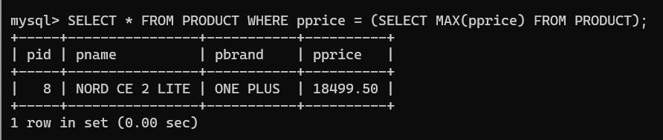
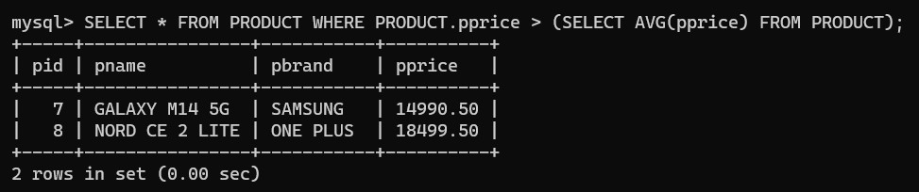
Retrieve all the details of products which have a maximum price.
Retrieve all details of the products whose price is greater than the average price of products in the table

Slide 19
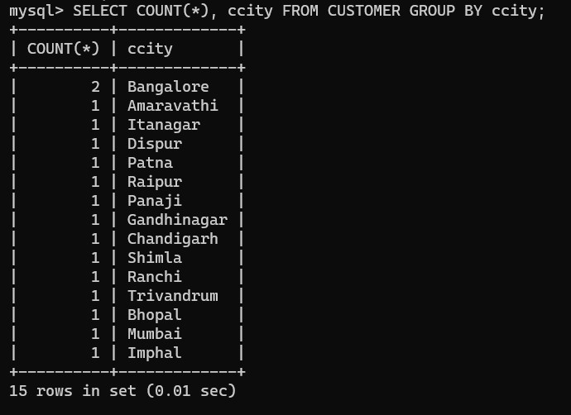
Retrieve the count of the city of customers:

Slide 20
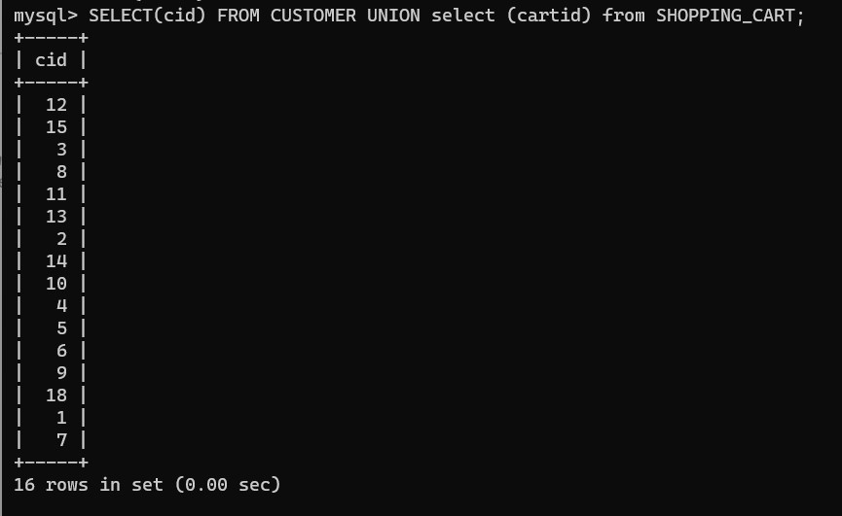

Slide 21
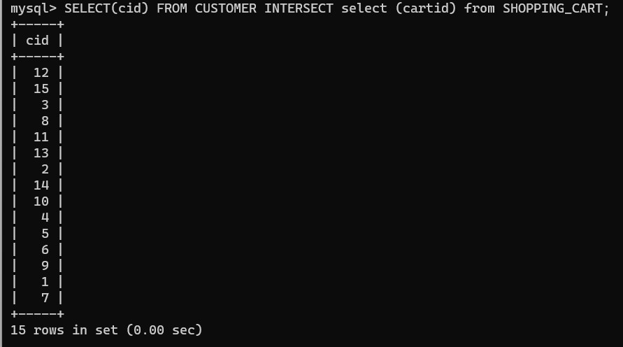

Slide 22
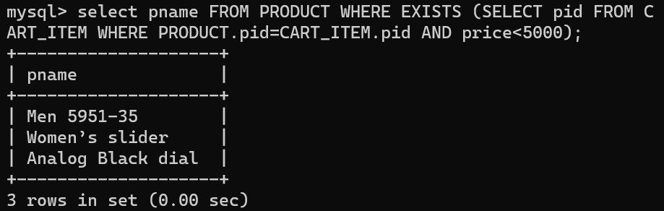
lists the products with a product price less than 5000
UPDATE CUSTOMER SET dob = '1980-07-09' where cid=1;
UPDATE CUSTOMER SET dob = '1977-07-11' where cid=2;
UPDATE CUSTOMER SET dob = '1963-12-26' where cid=3;
UPDATE CUSTOMER SET dob = '1971-09-18' where cid=4; UPDATE CUSTOMER SET dob = '1948-08-11' where cid=5;
UPDATE CUSTOMER SET dob = '1967-08-12' where cid=6;
UPDATE CUSTOMER SET dob = '1980-09-30' where cid=7;
UPDATE CUSTOMER SET dob = '1980-06-26' where cid=8;
UPDATE CUSTOMER SET dob = '1924-08-16' where cid=9;
UPDATE CUSTOMER SET dob = '1977-04-20' where cid=10;
UPDATE CUSTOMER SET dob = '2002-10-07' where cid=11;
UPDATE CUSTOMER SET dob = '1923-11-29' where cid=12;
UPDATE CUSTOMER SET dob = '1980-11-04' where cid=13;
UPDATE CUSTOMER SET dob = '1974-11-10' where cid=14;
UPDATE CUSTOMER SET dob = '1992-11-08' where cid=15;

Slide 23
Write a function to find the number of products with pid in shopping cart.
DELIMITER $$
CREATE FUNCTION no_of_products( product_id INT
)
RETURNS INT
DETERMINISTIC
BEGIN
DECLARE count INT;
SELECT COUNT(*) INTO count FROM CART_ITEM WHERE pid = product_id;
RETURN count;
END $$
DELIMITER ;

Slide 24
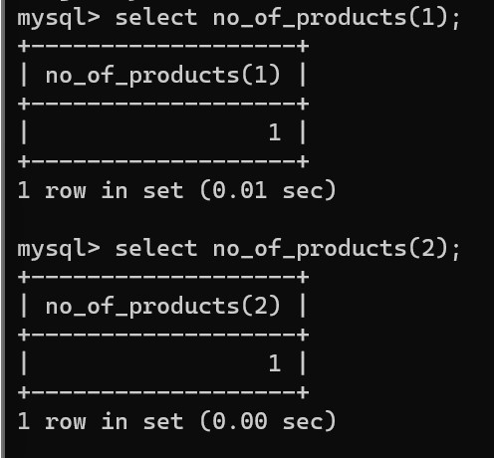

Slide 25
Write a stored procedure to calculate the age of the customer when the date of birth is given. Update the column named age in the customer table.
DELIMITER $$
CREATE PROCEDURE calculate_age_final(
user_id INT
)
BEGIN
DECLARE age INT;
UPDATE CUSTOMER SET age = TIMESTAMPDIFF(YEAR, DOB,
CURDATE()) WHERE user_id=cid; END $$
DELIMITER ;
call calculate_age_final(1); call calculate_age_final(2); call calculate_age_final(3); call calculate_age_final(4); call calculate_age_final(5); call calculate_age_final(6); call calculate_age_final(7); call calculate_age_final(8); call calculate_age_final(9); call calculate_age_final(10); call calculate_age_final(11); call calculate_age_final(12); call calculate_age_final(13); call calculate_age_final(14); call calculate_age_final(15);

Slide 26
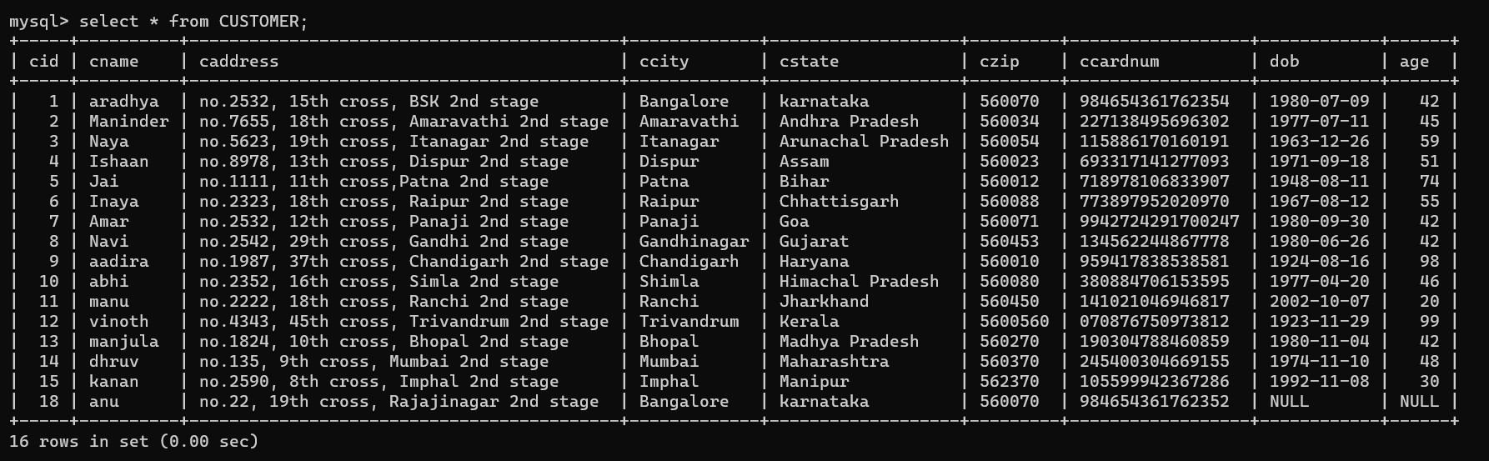

Slide 27
Create triggers that, when the price of a certain product changes, update the price of this item in any active shopping cart containing the item, and also updates the total price of these shopping carts?.
DELIMITER $$
CREATE TRIGGER product_priceupdate
AFTER UPDATE ON product
FOR EACH ROW
BEGIN
UPDATE cartitem i JOIN shoppingcart c
ON i.cartid = c.cartid
SET i.iprice = NEW.pprice
WHERE i.pid = NEW.pid
AND c.active = 1;
UPDATE shoppingcart c JOIN
(
SELECT cartid, SUM(iprice * iquantity) totalprice
FROM cartitem
WHERE cartid IN
(
SELECT DISTINCT i.cartid
FROM cartitem i JOIN shoppingcart c
ON i.cartid = c.cartid
WHERE i.pid = NEW.pid AND c.active = 1
) GROUP BY cartid
) q
ON c.cartid = q.cartid SET c.totalprice = q.totalprice;
END$$
DELIMITER ;

Slide 28
import mysql.connector
import streamlit as st
import pandas as pd
db = mysql.connector.connect(
host="localhost",
port="3307",
user="root",password="Mitha@03",
database="proj_final“
)
cursor = db.cursor()
st.title("Product Details")
cursor.execute("SELECT * FROM PRODUCT")
st.dataframe(pd.DataFrame(cursor.fetchall(), columns=("pid", "pname",
"pbrand", "pprice")))

Slide 29
st.subheader("Add a new product")
pid = st.number_input("pid",key="pid_create")
pname = st.text_input("pname",key="pname_create")
pbrand = st.text_input("pbrand",key="pbrand_create")
pprice = st.number_input("pprice",key="pprice_create")
if st.button("Add Product"):
cursor.execute("INSERT INTO PRODUCT VALUES (%s, %s, %s, %s)", (pid, pname,pbrand, pprice))
db.commit()
st.success("product added successfully")
st.subheader("Update a product")
pid = st.number_input("pid",key="pid_update")
pname = st.text_input("pname",key="pname_update")
train_type = st.text_input("pbrand",key="pbrand_update")
pprice = st.number_input("pprice",key="pprice_update")
if st.button("Update product"):
cursor.execute("UPDATE product SET pname = %s, pbrand = %s, pprice =
%s,WHERE Train_no = %s", (pname, pbrand, pprice, pid))
db.commit()
st.success("PRODUCT updated successfully")
st.subheader("Delete a PRODUCT")
pid = st.number_input("pid",key="pid_delete")
if st.button("Delete PRODUCT"):
cursor.execute("DELETE FROM PRODUCT WHERE pid = %s", (pid,))
db.commit()

Slide 30
st.success("PRODUCT deletedsuccessfully")
cursor.close()db.close()

Slide 31
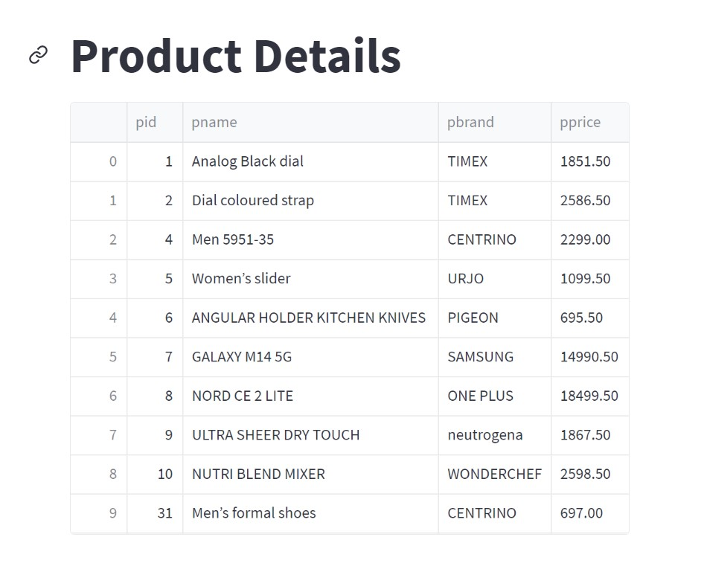
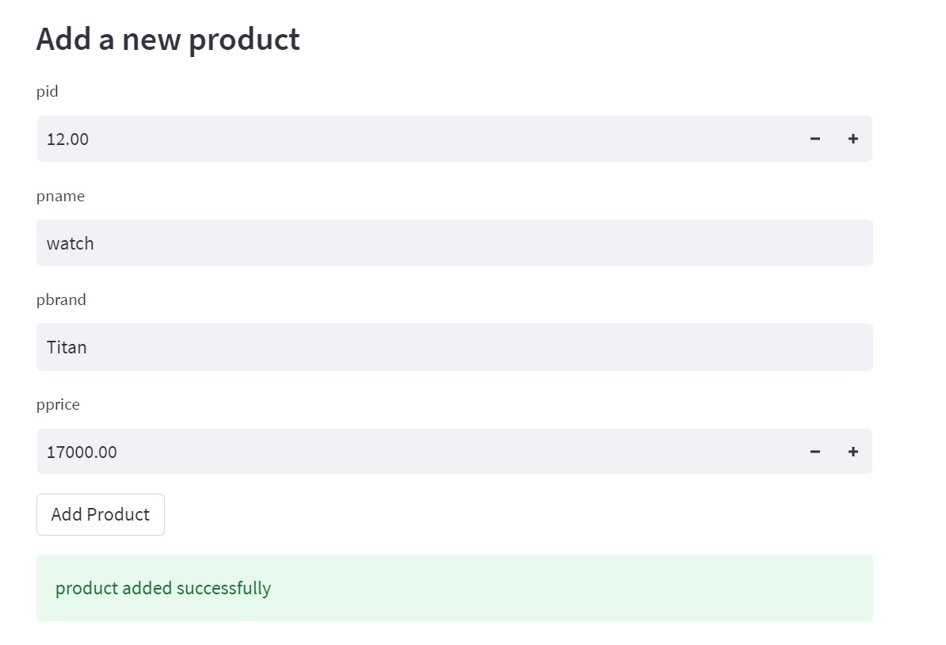

Slide 32
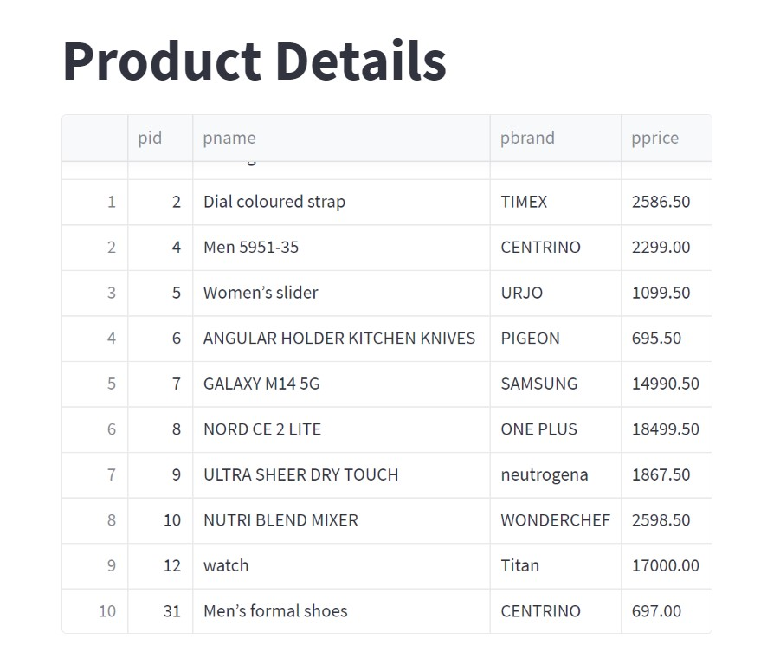
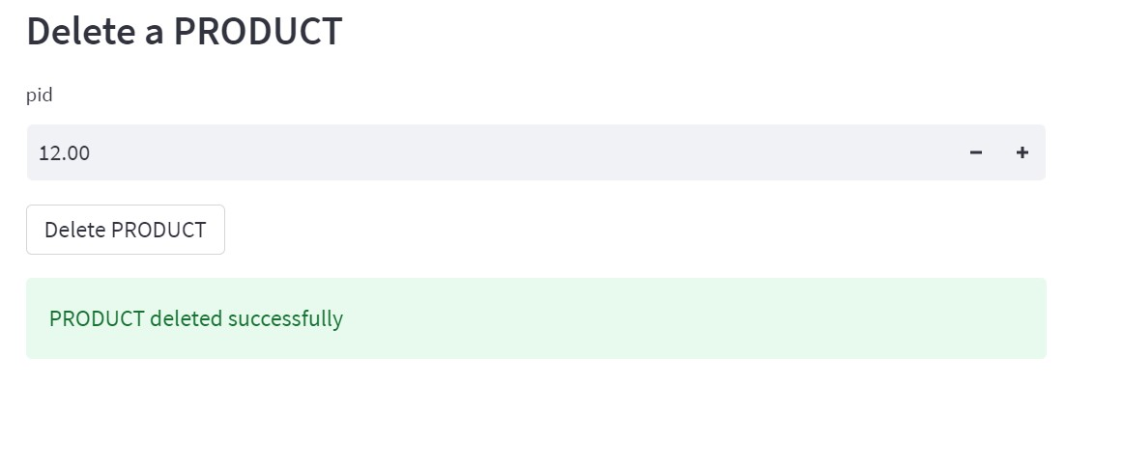

Slide 33
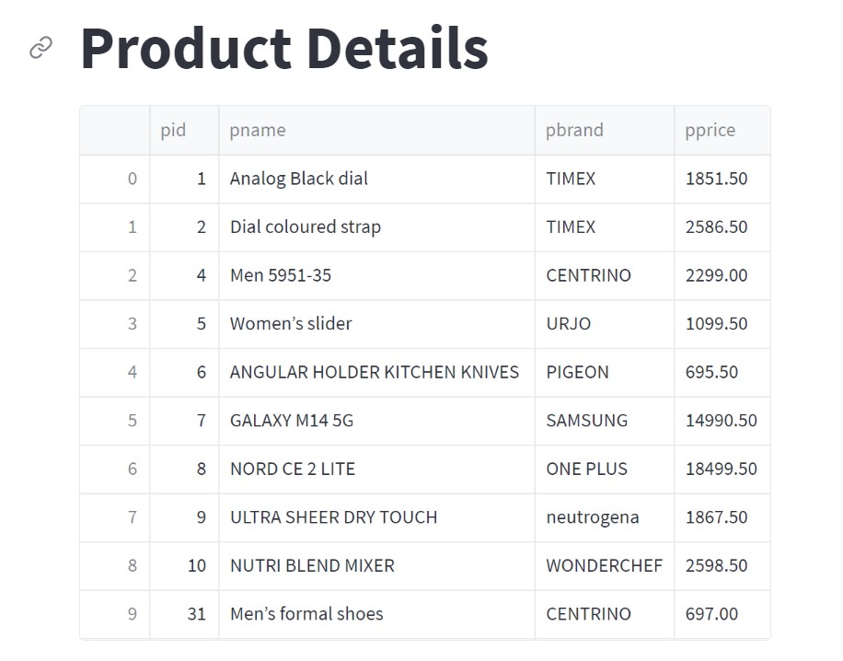

Slide 34
import mysql.connector import streamlit as st import pandas as pd db = mysql.connector.connect( host="localhost", port="3307", user="root", password="Mitha@03", database="proj_final" ) cursor = db.cursor() st.title("CART Details") cursor.execute("SELECT * FROM shopping_cart") st.dataframe(pd.DataFrame(cursor.fetchall(), columns=("cartid", "cid", "active"))) st.subheader("Update status of customer") cartid = st.number_input("cartid", key="cartid_update") active = st.number_input("active", key="active_update") if st.button("Update product"): cursor.execute("UPDATE shopping_cart SET active = %s, WHERE cartid = %s ", (active,cartid)) db.commit() st.success("status updated successfully") cursor.close() db.close()

Slide 35
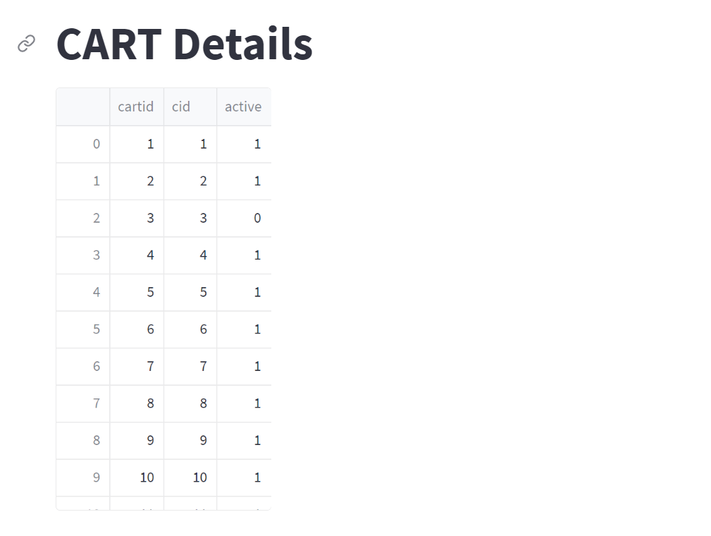
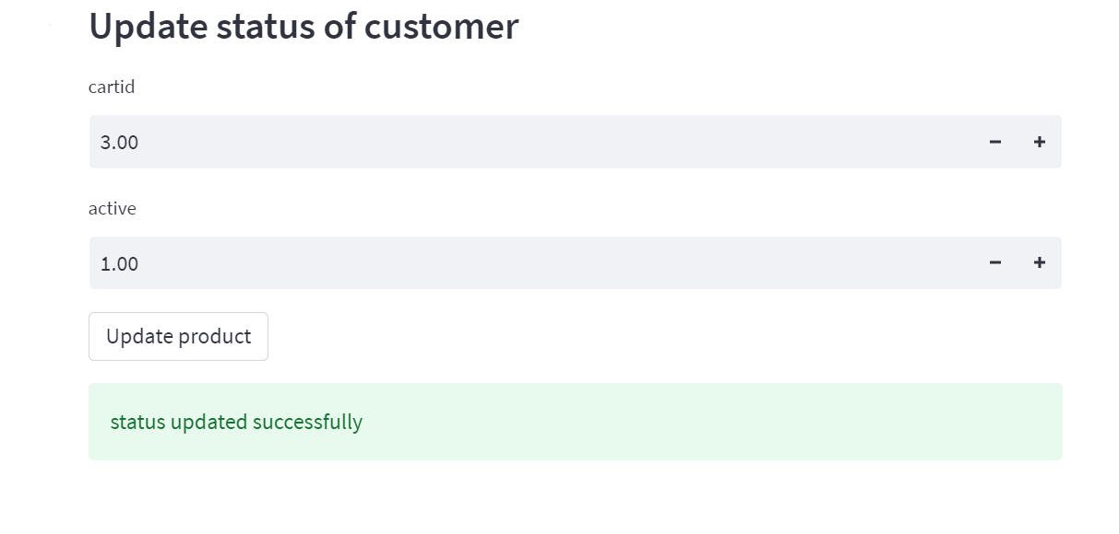

Slide 36
